Slide 1

UNIVERSITY OF GONDAR
COLLEGE OF NATURAL AND COMPUTATIONAL SCIENCE
DEPARTMENT OF INFORMATION TECHNOLOGY(MSC)
Project Title:-Predicting Students Health Information Using Data Mining Technique: in case of UOG Atse Tewdrous Campus Student Clinic
By :- Alehegn Adane
Lema Misgan
Lakew Tarekegn
June,2015

Slide 2

Presentation Outline:
      Introduction
      Dataset problem
      Objective
      Methodology(tool and Algorithm used)
      sample dataset(snapshoot)
      sample Code

Slide 3
Introduction
Data mining is the process of discovering interesting patterns (or knowledge) from large amounts of data or extracting or “mining” knowledge from large amounts of data.
Classification is the process of finding a model (or function) that describes and distinguishes data classes or concepts
University of Gondar formerly called College of Medical Sciences. It is the oldest and most popular medical school in Ethiopia.
Data mining classification technique is used for predicting student’s medical health problem.

Slide 4
Dataset problem
UOG Students health information is affected by different types of diseases which leads to Students low academic performances, withdrawal and Death.
Unable to predict students health information based on the existing information.
Lack of organized data are major problem of the clinic.

Slide 5
objective
General objective
The general objective of our project is to predict student’s health information using data mining classification technique by referring previous clinical history of students.
Specific Objectives
To collect data from student’s clinic,
To preprocess the collected row data,
To develop model,
To evaluate the accuracy of different classification algorithms,
To read data mining related literature

Slide 6
Methodology followed
Data preprocessing
100 and 28 number of Instances and number of attributes has been taken for this project respectively.
steps
Encoding of the patient records into excel format,
we convert the excel file(.xlsx) format into .CSV (comma delimited value) file type,
Finally, convert the .CSV file type into .Arff format
Tools and Algorithm Used
We used WEKA 3.7.9 version.
Trees - J48 and Bayes- Naive bayes

Slide 7
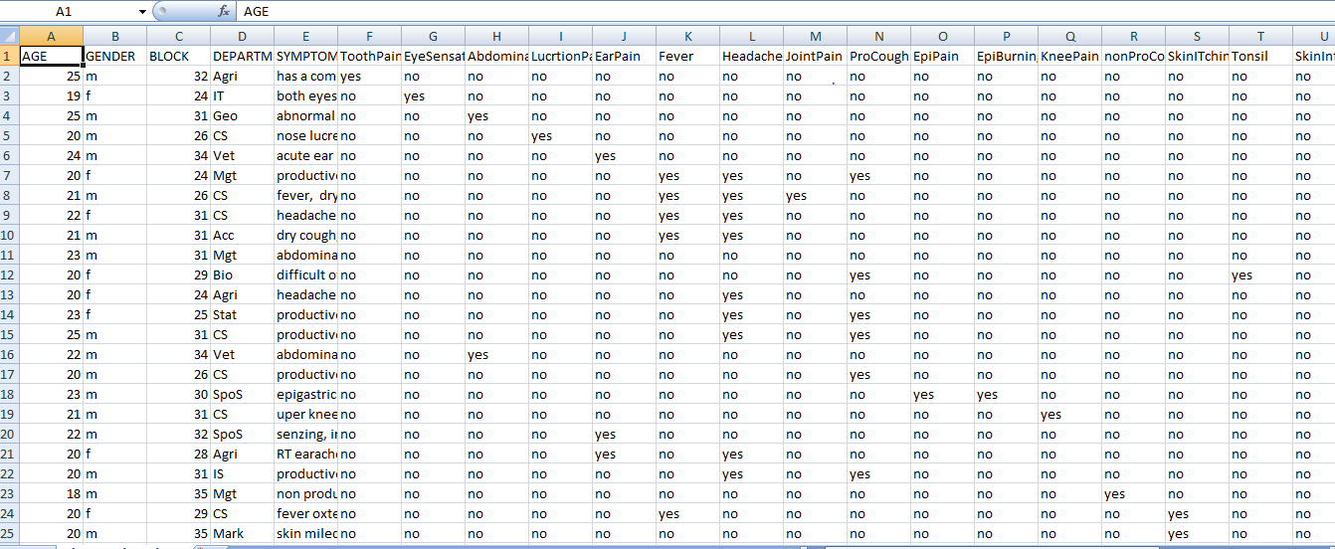
.CSV data set format

Slide 8
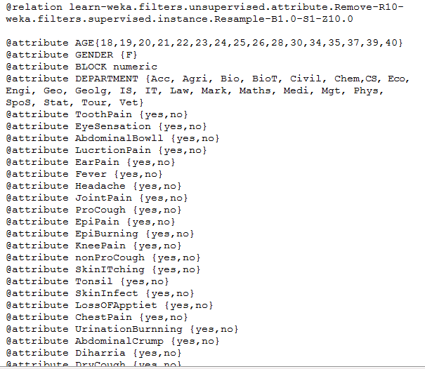
.arff dataset format

Slide 9

Cont…

Slide 10
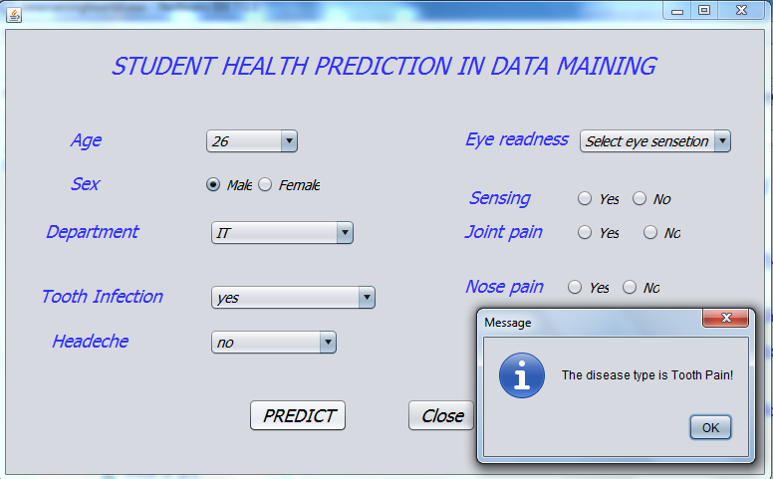

Slide 11
Thanks to all!
Question?

